Slide 1
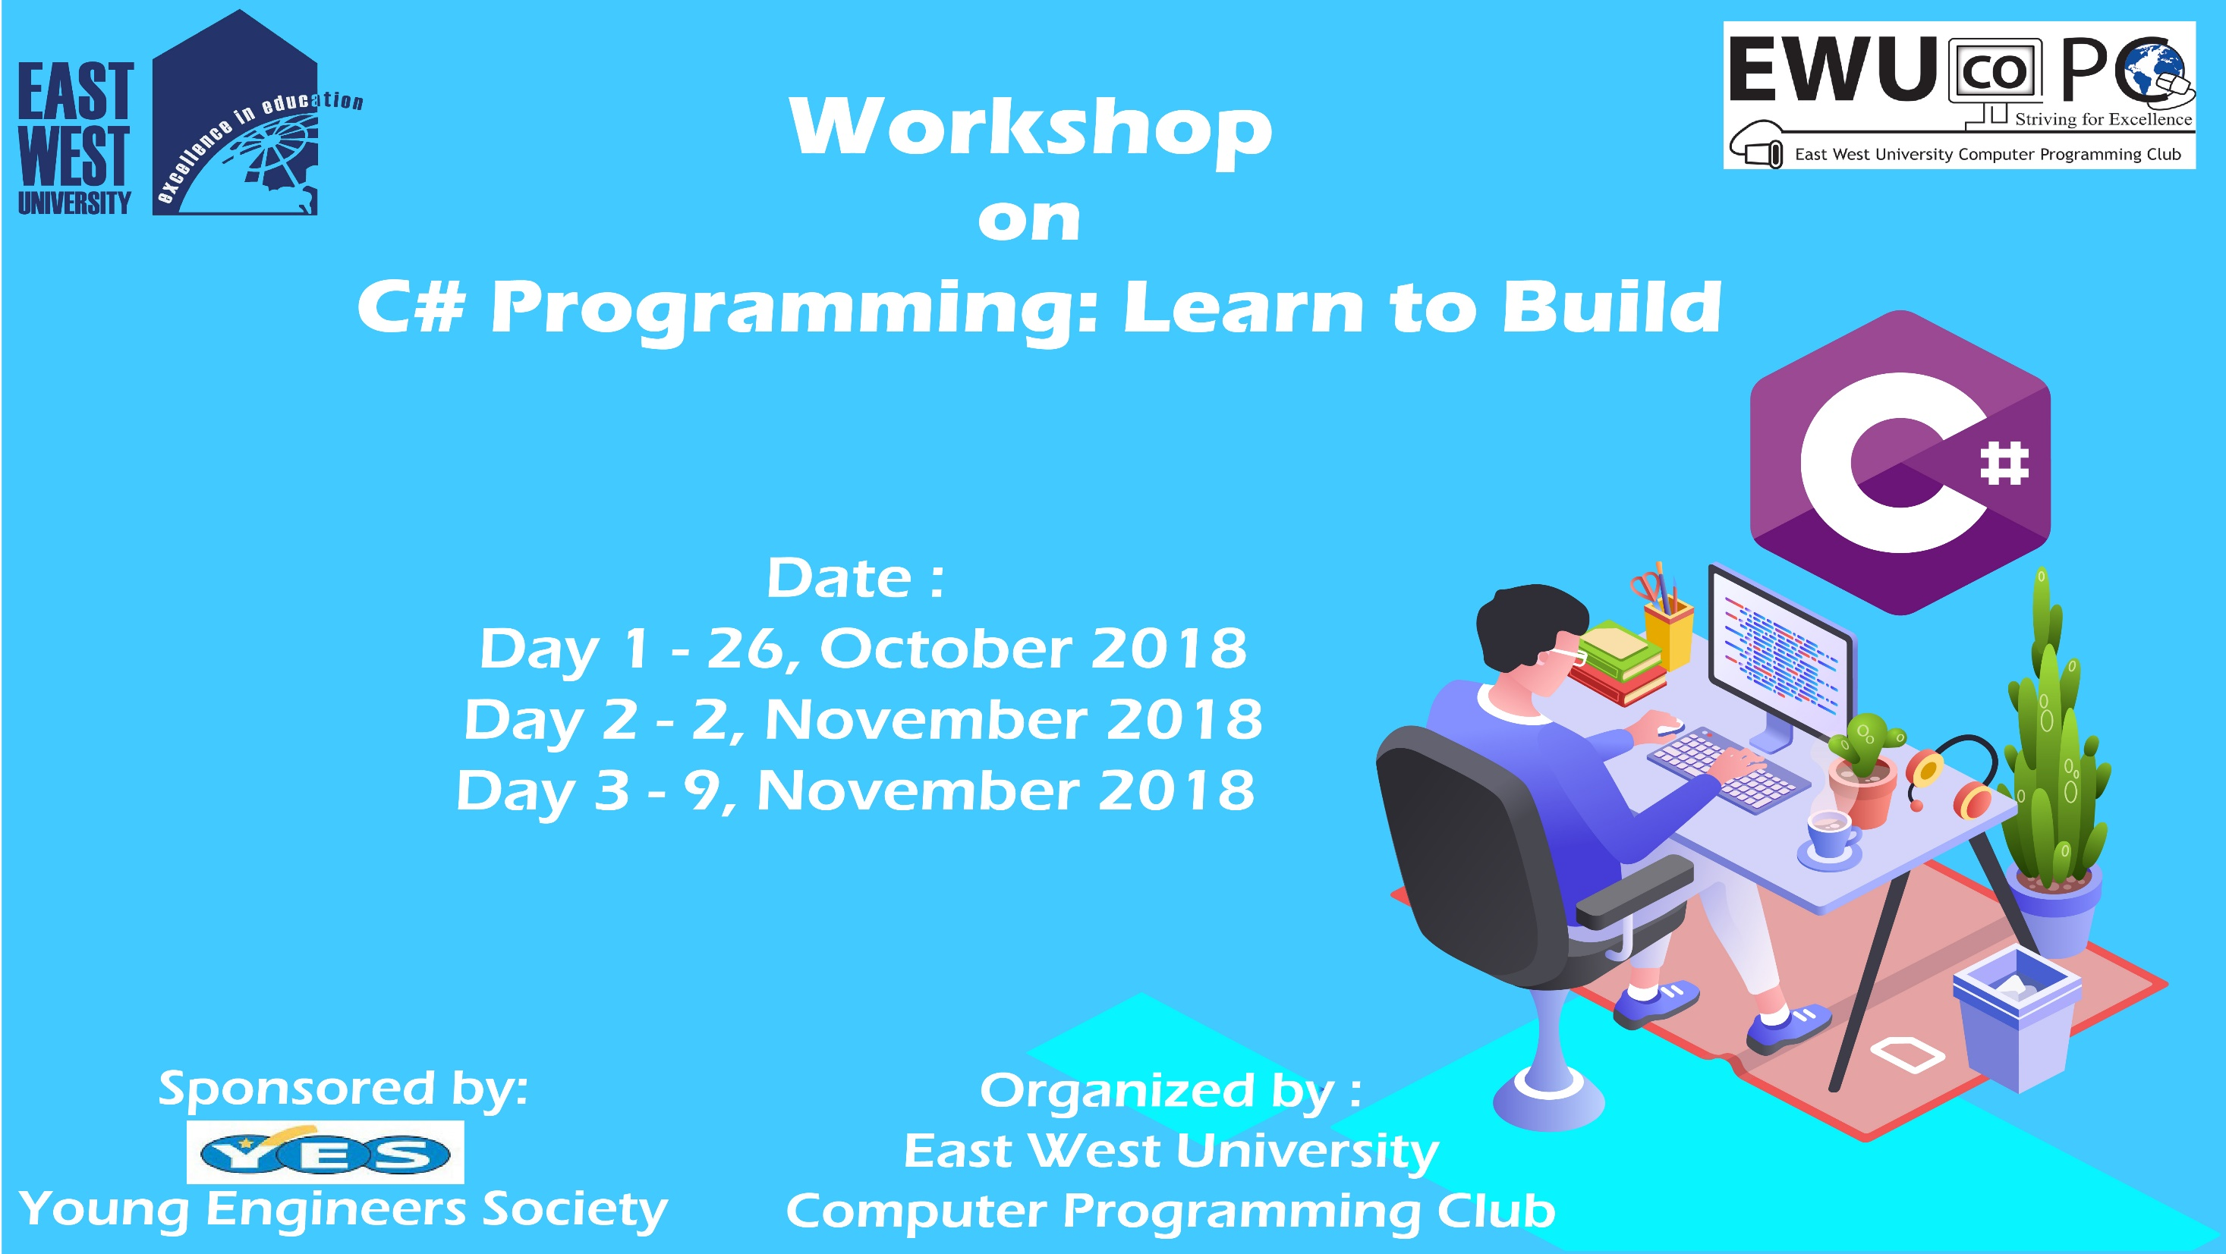

Slide 2
C# Day 2 Lecture10: String

Slide 3
String
string firstname, lastname;
firstname = "Mushfiqur";
lastname = "Rahman";

Slide 4
String
string name = firstname +" "+ lastname;
Console.WriteLine(name);

Slide 5
String
string fullname = String.Concat(firstname,"+", lastname);
Console.WriteLine(fullname);

Slide 6
String
Console.WriteLine("Hello {0}", firstname + " " + lastname);
Console.WriteLine("how are you " + firstname + " " + lastname +" ? ");

Slide 7
String
char[] letters = { 'H', 'E', 'L', 'L', 'O' };
string st = new string(letters);
Console.WriteLine("Hello " + st);

Slide 8
String
char[] let = st.ToCharArray();
foreach (char a in let)
{
Console.WriteLine(a);
}

Slide 9
String
string[] words = { "how", "are", "you", "?" };
string sentence = String.Join(" ", words);
Console.WriteLine(sentence);

Slide 10
String
string sentences = "Hello World";
string lower = sentences.ToLower();
string upper = sentences.ToUpper();
Console.WriteLine("Upper " + upper + " Lower " + lower);

Slide 11
String
string bd = "I love my country very much";
Console.WriteLine(bd.StartsWith("I")); Console.WriteLine(bd.EndsWith("h")); Console.WriteLine(bd.Contains("very"));

Slide 12
This slide is provided as a course material in the workshop named “Workshop on C# Programming: Learn to Build”.
Organized by-
East West University Computer Programming Club (EWUCoPC)
Prepared by- Jannat Binta Alam
Campus Ambassador
Young Engineers Society (YES)
E-mail: jannat.cse.ewu@gmail.com

